Slide 1
Leveraging Intune, Defender XDR, and Graph API for data-informed projects
Fantastic data and where to find them

Slide 2
Attention
MMS sessions are 60-75 minutes followed by LONG Q&A
Please hold detailed questions until that Q&A starts
Feel free to ask clarification questions
Remind the speakers to use Zoom It when you can’t see

Slide 3




Jordan Benzing
Nathan McNulty
Microsoft MVP, Engineer Patch My PC
Sr. Security Solutions Architect Patriot Consulting
@JordanTheITGuy
nathan@nathanmcnutly.com @nathanmcnulty

Slide 4
The Data Discovery Journey
Graph API
Midwater dive into Graph PowerShell and Graph API
Intune
Graph API, Data warehouse, Remediations, and Device Query
Defender XDR
Extending Defender data with Live Response and Sentinel
Examples
Notes:
Historically, we have had access to a lot more data with our on-prem services, but the data models were all over the place, required a lot of expertise to collect and normalize, and was generally a pain to centralize. So while we had far more data available, it was difficult to collect and use.
When building cloud offerings, Microsoft was selective with what data is collected and exposed to ensure performance and scalability, but most of us always want more ;)
This is obviously a non-exhaustive list of resources we can tap into to discover current and historical information, but the key here is that we always want to gather any data that can help us inform decisions for projects or secure our environment. Some data like amount of RAM are readily available and easy to identify machines that could be upgraded, but other things such as screen size or performance metrics are more challenging to collect.
The primary focus here will be on identity and devices, but these techniques apply to other areas like infrastructure, data, applications, and compliance related projects as well.
The goal here is to show how we can start to get at our data, some examples to build ideas off of, and collect feedback on areas that you might want to see some more samples – yes, I would love to build some things for you ☺

Slide 5
Graph API
The one API to rule them all

Slide 6
Tolerating Graph PowerShell
Translating from MSOnline and AzureAD modules
Navigating the Graph modules and documentation
Discovering cmdlets, parameters, properties, and filters
Tips moving from interactive to non-interactive applications
Notes:
History of MSOnline and AzureAD modules – Azure AD Graph API
Discuss Graph API as a resource, Graph PowerShell as an app just like a browser is an app, and how consent / authorization work
https://learn.microsoft.com/en-us/powershell/microsoftgraph/azuread-msoline-cmdlet-map?view=graph-powershell-1.0
https://learn.microsoft.com/en-us/powershell/microsoftgraph/azuread-msoline-cmdlet-map?view=graph-powershell-1.0
https://learn.microsoft.com/en-us/powershell/microsoftgraph/use-query-parameters?view=graph-powershell-1.0

Slide 7
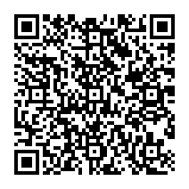
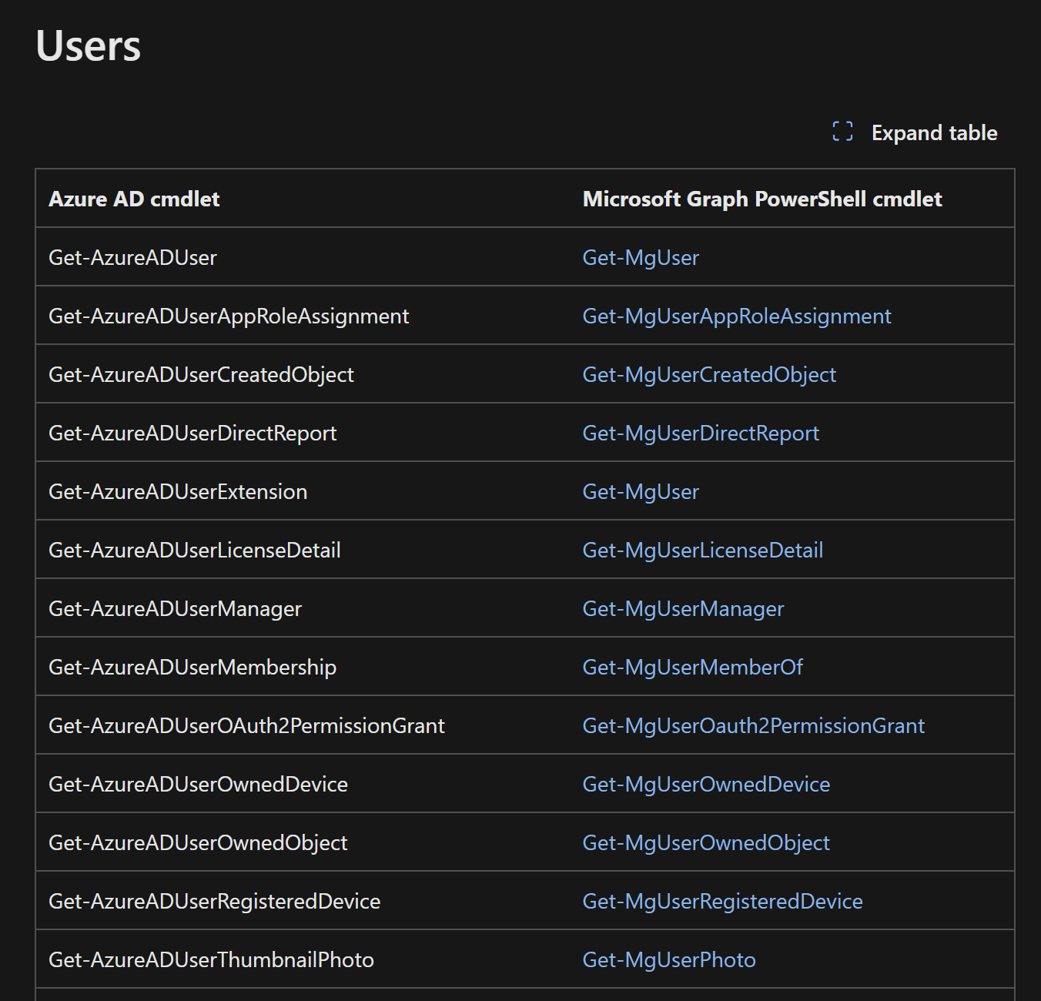
The Official Cmdlet Mapping
https://learn.microsoft.com/en-us/powershell/microsoftgraph/azuread-msoline-cmdlet-map

Slide 8
Understanding permissions
Find-MgGraphPermission!
Delegated permissions
Most commonly used for interactive sessions
Limits permissions to only what is approved for the app, even if the user has more permissions through a role, such as Global Admin
To allow more permissions, an admin must consent for the app
Application permissions
Most commonly used for non-interactive use, like scripts or applications
Limited to assigned permissions but can grant the user permissions they do not have through assigned roles
This model can present privilege escalation risks with some permissions ;)
Notes:
Usually use Find-MgGraphCommand to get permission needed
Find-MgGraphPermission -SearchString "Device"

Slide 9
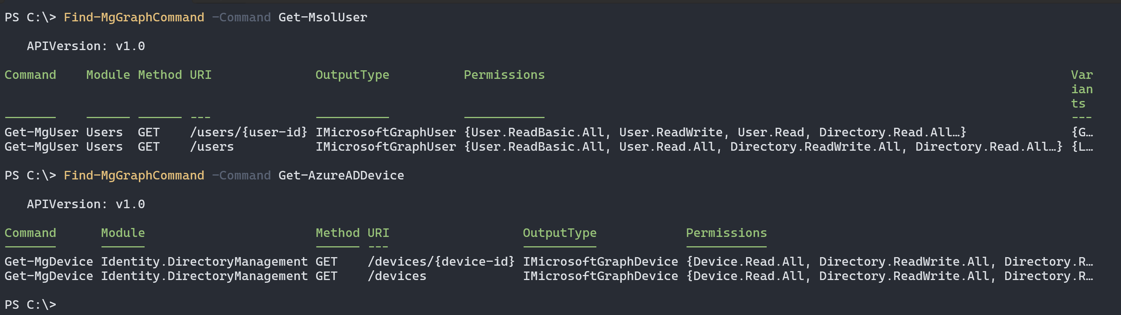
Using Find-MgGraphCommand
Bonus: Find-MgGraphPermission
Notes:
Get-Command -Module Microsoft.Graph.DeviceManagement* -Name Get-*
Get-Command -Module Microsoft.Graph.DeviceManagement* -Name Get-MgDeviceManagementUserExperienceAnalytic* | ft -AutoSize
Find-MgGraphCommand -Command Get-MgDeviceManagementDetectedApp | fl *
Find-MgGraphCommand -Command New-MgDeviceManagementDeviceConfiguration | fl *
Highlight the URI endpoint, Permissions, and URL (some beta commands don’t have this)
Find-MgGraphPermission -SearchString "Device"
Remove-MgBetaIdentityAuthenticationEventFlowAsOnGraphAPretributeCollectionExternalUserSelfServiceSignUpAttributeIdentityUserFlowAttributeByRef

Slide 10
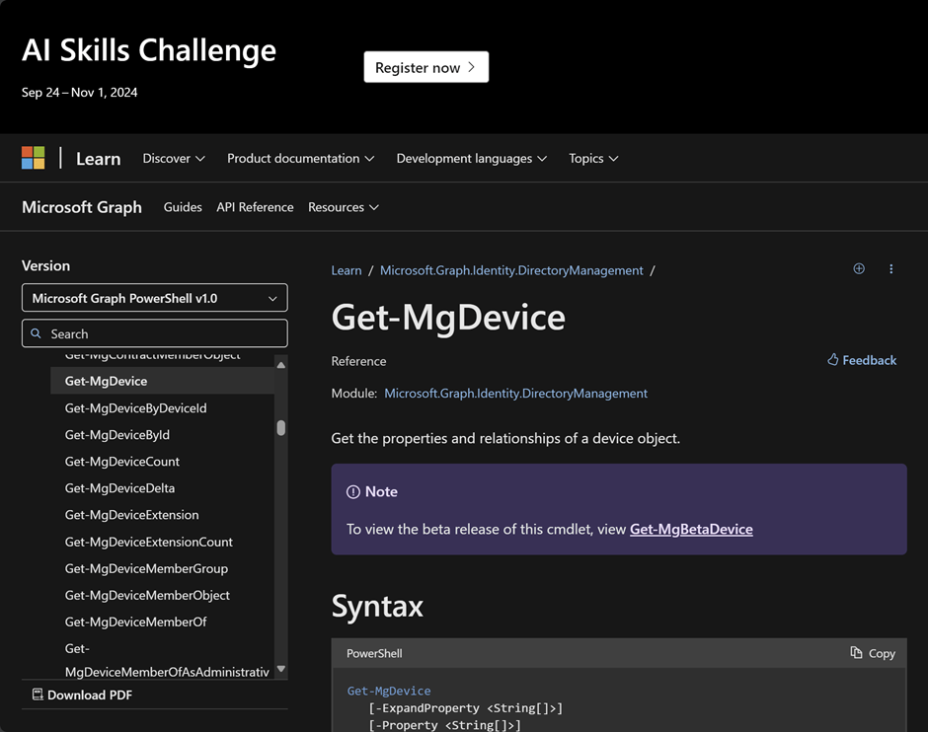
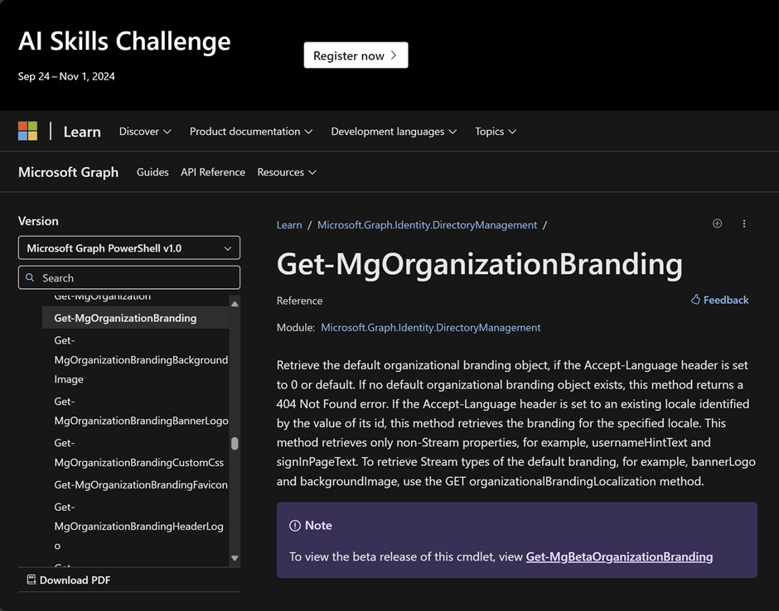
Docs that make you cry
Notes:
Hardly any descriptions, limited and often non-functional examples, and properties just dumped in a giant bullet list with no context

Slide 11
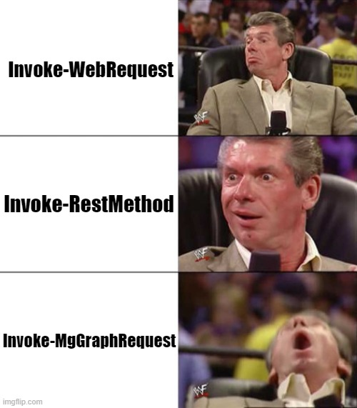
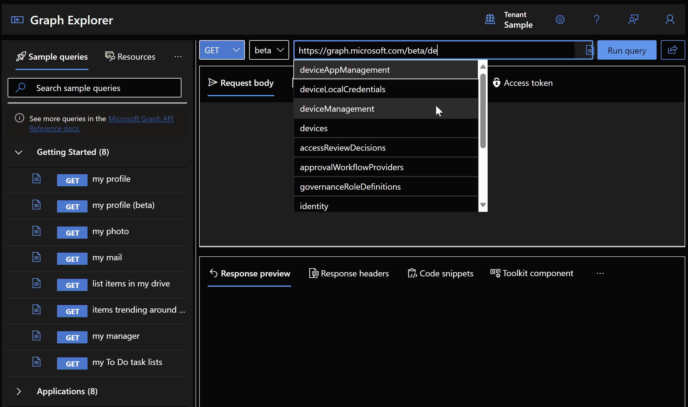
Making the right call
Notes:
Invoke-WebRequest is really designed for HTML type content, and while it can work with JSON and XML content, there are better options
Invoke-RestMethod is designed for working with REST APIs and has much better handling of JSON, converts to objects better, and will be easier to work with if dealing with pagination
Invoke-MgGraphRequest builds on Invoke-RestMethod and abstracts tokens, pagination, and some other headers so we don’t need to pass them with our requests (or makes it much easier to, like –ConsistencyLevel eventual)

Slide 12
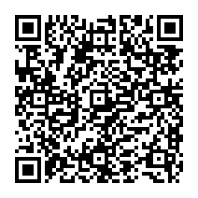
Performance considerations for automation
Limit data retrieved from API
-Property ($select)
-Filter
-Search
-Top
/delta/ endpoints
Techniques for limiting processing
.Count
Compare-Object
Measure-Object
https://learn.microsoft.com/en-us/powershell/microsoftgraph/use-query-parameters
Notes:
Map $select to –Property, filter, $count to –Top, etc. to limit data and improve performance / reduce runtime costs, also compare-object and webhooks
https://devblogs.microsoft.com/microsoft365dev/build-advanced-queries-with-count-filter-search-and-orderby/ https://ourcloudnetwork.com/understanding-consistencylevel-eventual-with-microsoft-graph-powershell/
-Property
Get-MgDevice
(Get-MgDevice)[0] | fl *
(Get-MgDevice -Property DisplayName,OperatingSystem)[0] | fl *
-Filter
Get-MgDevice -Filter "DisplayName eq 'sml-cl01’”
Get-MgDevice -Filter "startsWith(DisplayName,'sml’)”
Get-MgGroup -Filter "not(groupTypes/any(c:c eq 'Unified'))" # Throw error on purpose, show how to fix
-Search
Get-MgDevice -Search "displayName:cl01" -ConsistencyLevel eventual
-Top
Get-MgUser -Top 10
https://learn.microsoft.com/en-us/graph/delta-query-overview

Slide 13
Exploring Graph PowerShell
Yes, it’s not the AzureAD modules
Notes:
Browse the Intune portal, grab the API call, map back to cmdlets with docs
Walk through process for Entra device cleanup – discover docs, perms, authz, backup bitlocker keys and delete
Find-MgGraphCommand –Command *Device*
Find-MgGraphCommand -Command Remove-MgDevice | fl
Let’s check the doc – delegated vs application permission
Grant permission for delegated vs app registration with API permission plus self signed certificate
Get-MgInformationProtectionBitlocker
Wait a minute!
Find-MgGraphCommand -Command Get-MgInformationProtectionBitlocker | fl
Check the docs – permission, look at examples, realize you need a key, look at object
Get-MgInformationProtectionBitlockerRecoveryKey -Filter "deviceId eq 'da2f6920-d585-4e47-a9e5-71ae18e8456b'" Get-MgInformationProtectionBitlockerRecoveryKey -BitlockerRecoveryKeyId e2586702-d618-430e-ba24-8249fe6d702c | fl *
Get-MgInformationProtectionBitlockerRecoveryKey -BitlockerRecoveryKeyId e2586702-d618-430e-ba24-8249fe6d702c -Property Key | fl *
Remove-MgDevice

Slide 14
Let’s look at Graph API
Mapping back to Graph PowerShell
Exploring permissions
Making native API calls
Batching and webhooks
Notes:
Show how to correlate cmdlets with API docs, helps find permissions and all objects/attributes
https://graphpermissions.merill.net/permission/
https://developer.microsoft.com/en-us/graph/graph-explorer

Slide 15
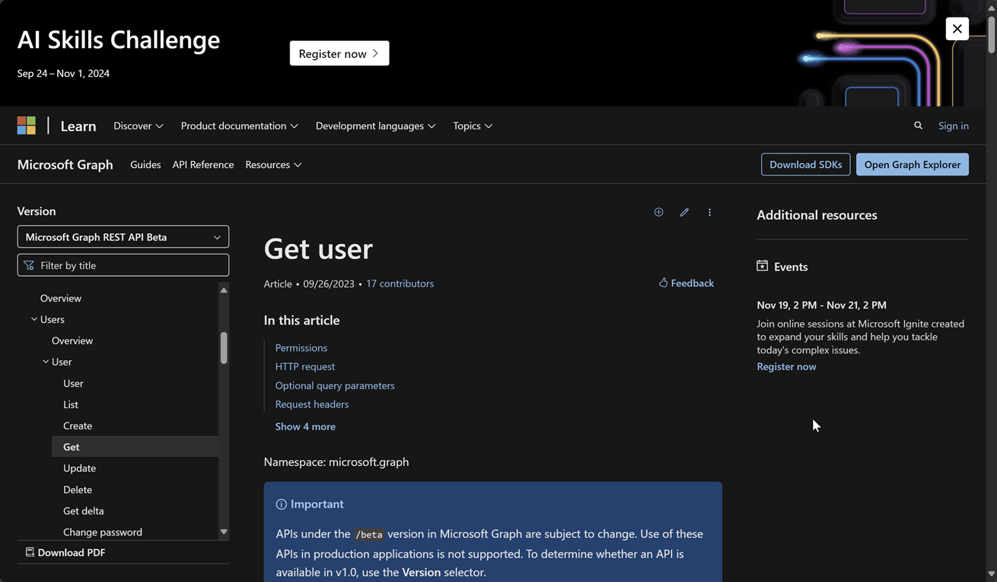
Docs that make you happier

Slide 16
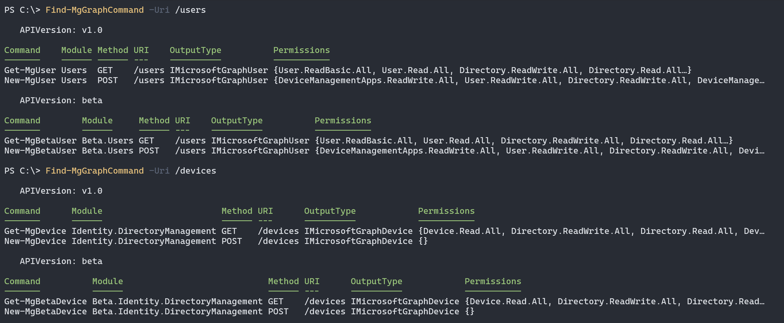
Find-MgGraphCommand, again! ☺

Slide 17

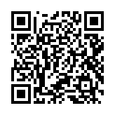
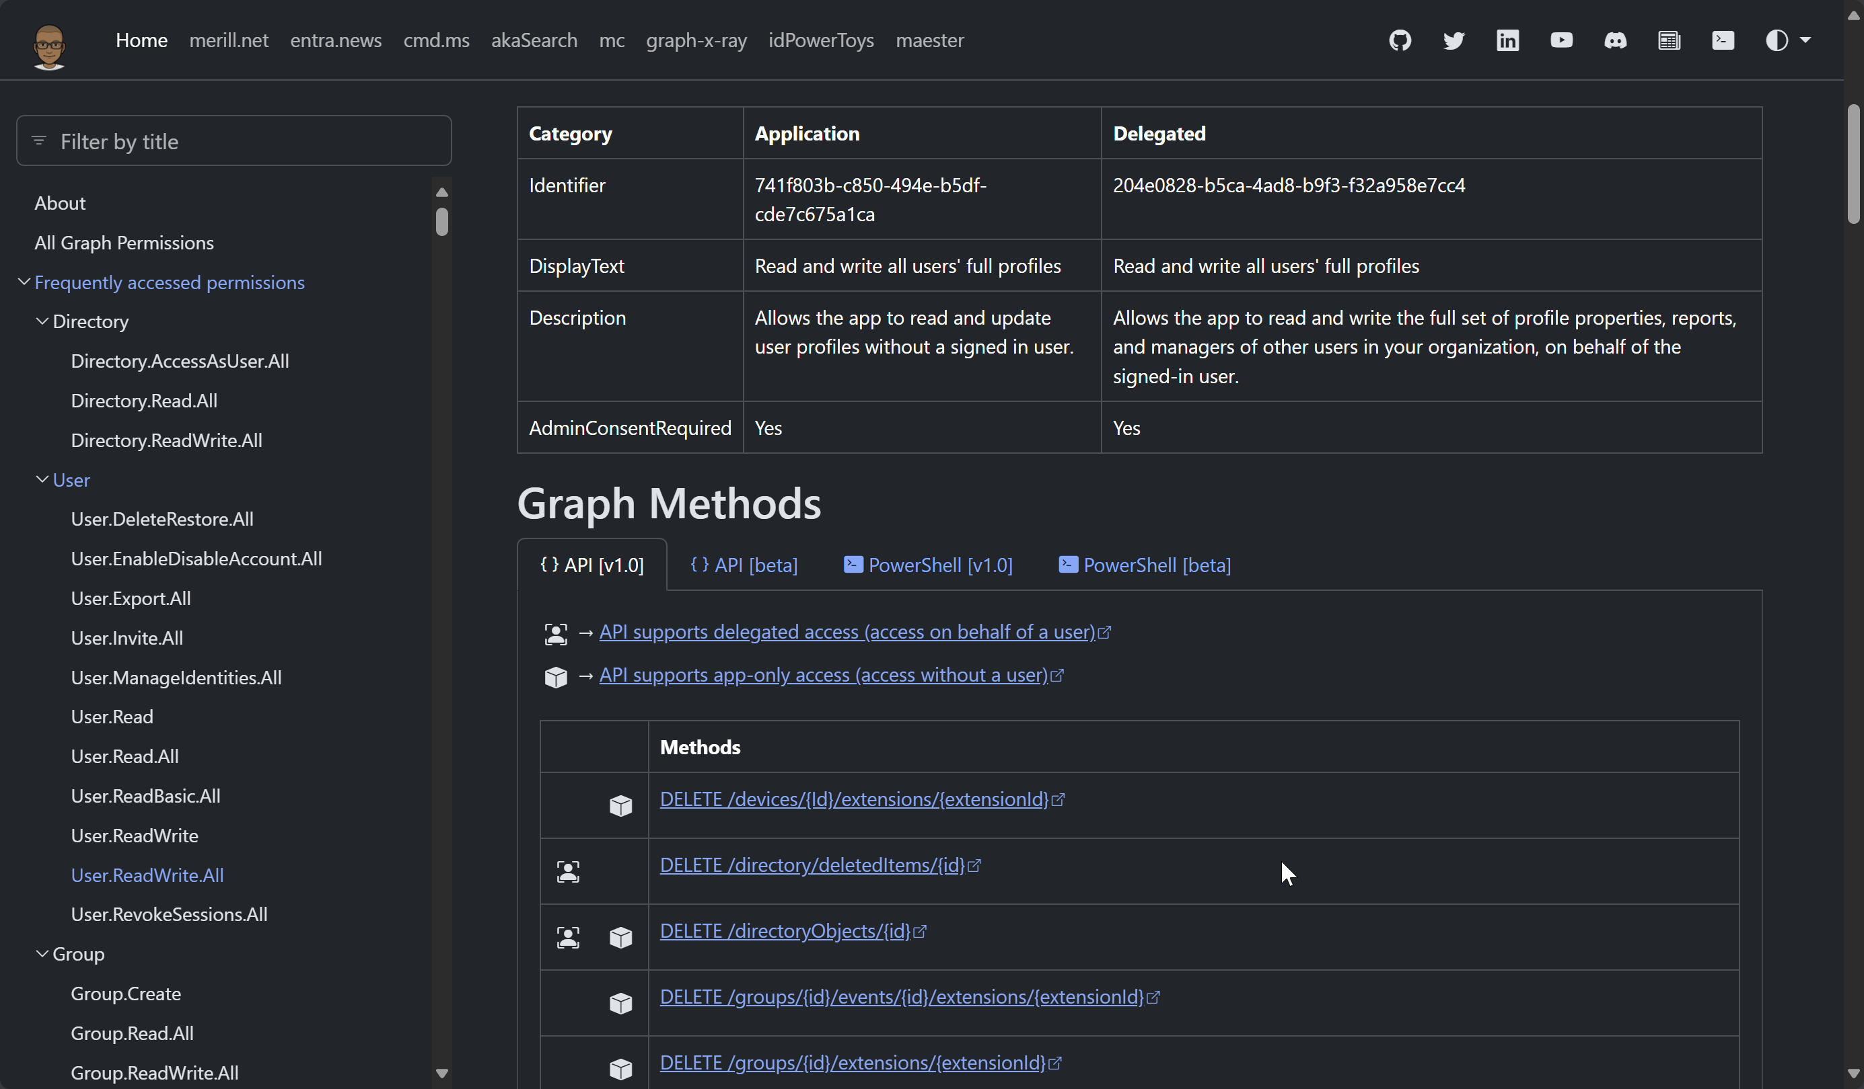
Merill is awesome!
https://graphpermissions.merill.net/permission/

Slide 18
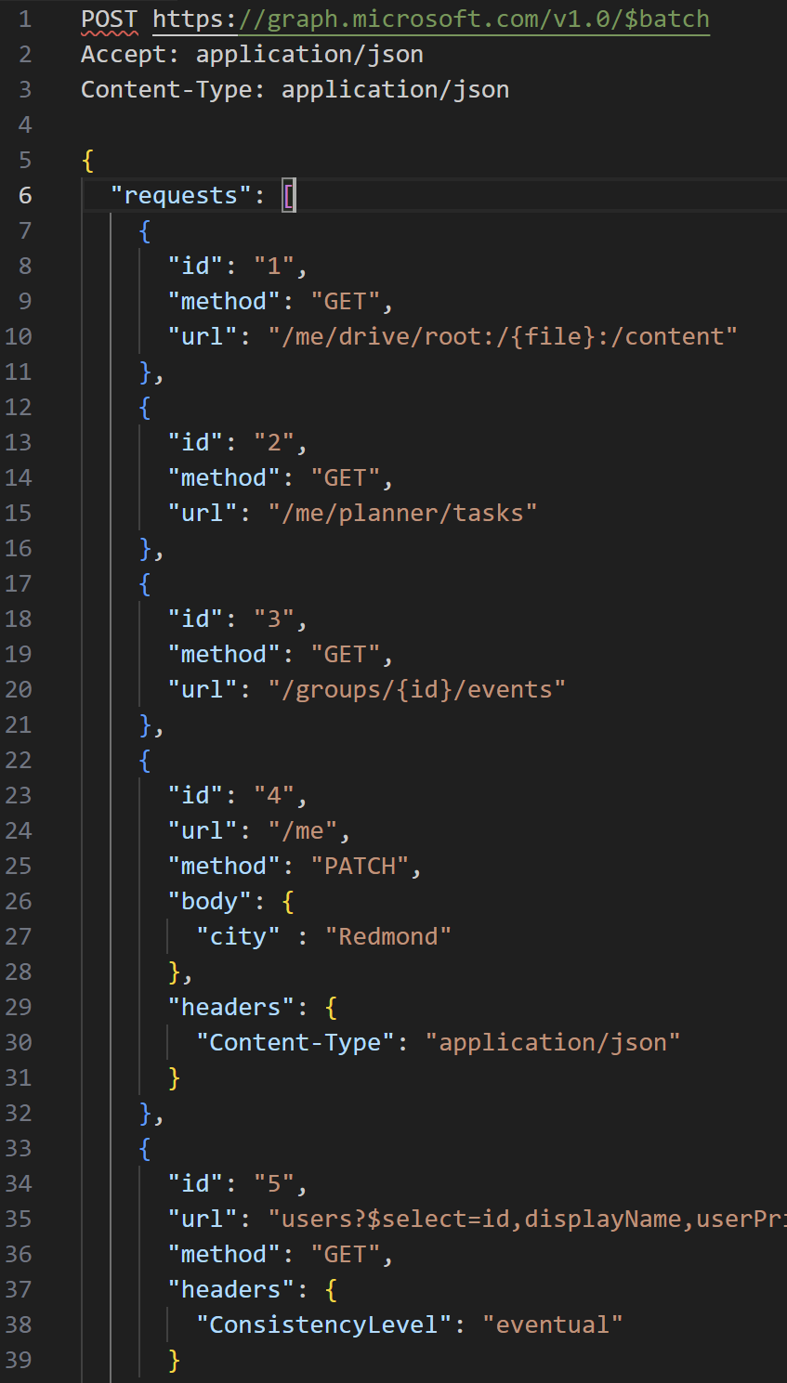
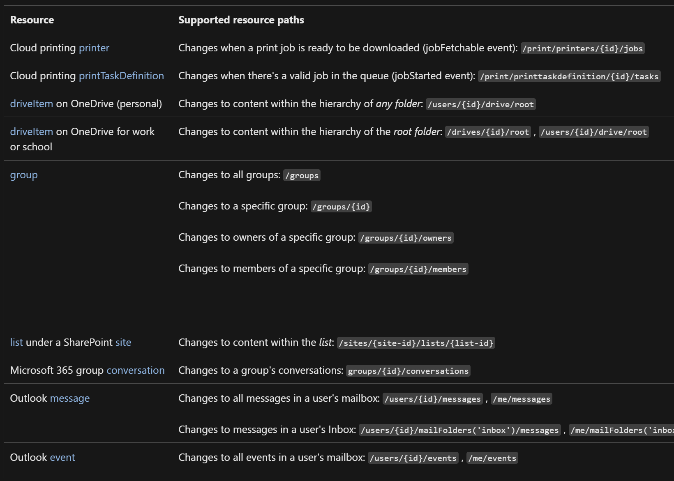
Advanced API Techniques
Batching
Change notification (webhook)

Slide 19
Exploring Graph API
Talking natively to Graph
Notes:
Graph Explorer
GET https://graph.microsoft.com/v1.0/users/adrianemorrison@sharemylabs.com/authentication/methods
Create TAP
https://learn.microsoft.com/en-us/graph/api/authentication-post-temporaryaccesspassmethods?view=graph-rest-1.0&tabs=http
POST https://graph.microsoft.com/v1.0/users/adrianemorrison@sharemylabs.com/authentication/temporaryAccessPassMethods
{ "lifetimeInMinutes": 60, "isUsableOnce": false }

Slide 20
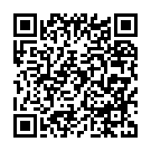
Bonus: Power BI
We can connect Power BI to Graph API to create dashboards
This uses Oauth 2.0 and Odata.Feed or Web.Contents
Unlike Intune, there is no additional data stored here
https://tech-peanuts.com/2020/05/28/connecting-power-bi-to-microsoft-graph/

Slide 21
Intune
If you have devices, we have data

Slide 22
Intune Graph API
Exploring the data available in Graph API
More than just data, we have actions!
Tips and tricks for discovering and automating API calls
Bonus: Audit logs
Notes:
We know how to look at device details, installed apps, configuration profiles, reports, etc. in the Intune portal, but usually this is a per-device or per-policy view that isn’t super helpful if we want an aggregated or averaged view of things. To collect this information at scale for analysis, our first stop should be the Intune Graph API, but before we start, it’s helpful understand APIs, authentication, and permissions.
https://learn.microsoft.com/en-us/graph/api/resources/intune-graph-overview?view=graph-rest-1.0
In Intune, we have many actions each of the devices can perform, such as sync, collect diagnostics, rotate BitLocker keys or LAPS passwords. We can use the API to automate tasks based on activity time, an incident, or other data gathering needs. During projects, we usually have different phases where we’re waiting on clients to check in, apply policies, or maybe validate new settings, and this provides us with a way to quickly identify issues more quickly.
Working with Graph API can be overwhelming, and often times it can feel impossible to figure out how to do things using the docs. In most cases, it will be more beneficial to perform the task (create or modify a policy, invoke an action, etc.) and look at the API calls that are being made to figure out how we can accomplish the same thing via Developer Tools or something like Fiddler or Burp Suite. Template based policies are common policies are great examples of this, but also sometimes it’s not clear which API some of the data is being presented from.
Finally, an often overlooked source of information is the audit logs which can be really helpful to cross reference the time when policies were modified and what was changed.

Slide 23
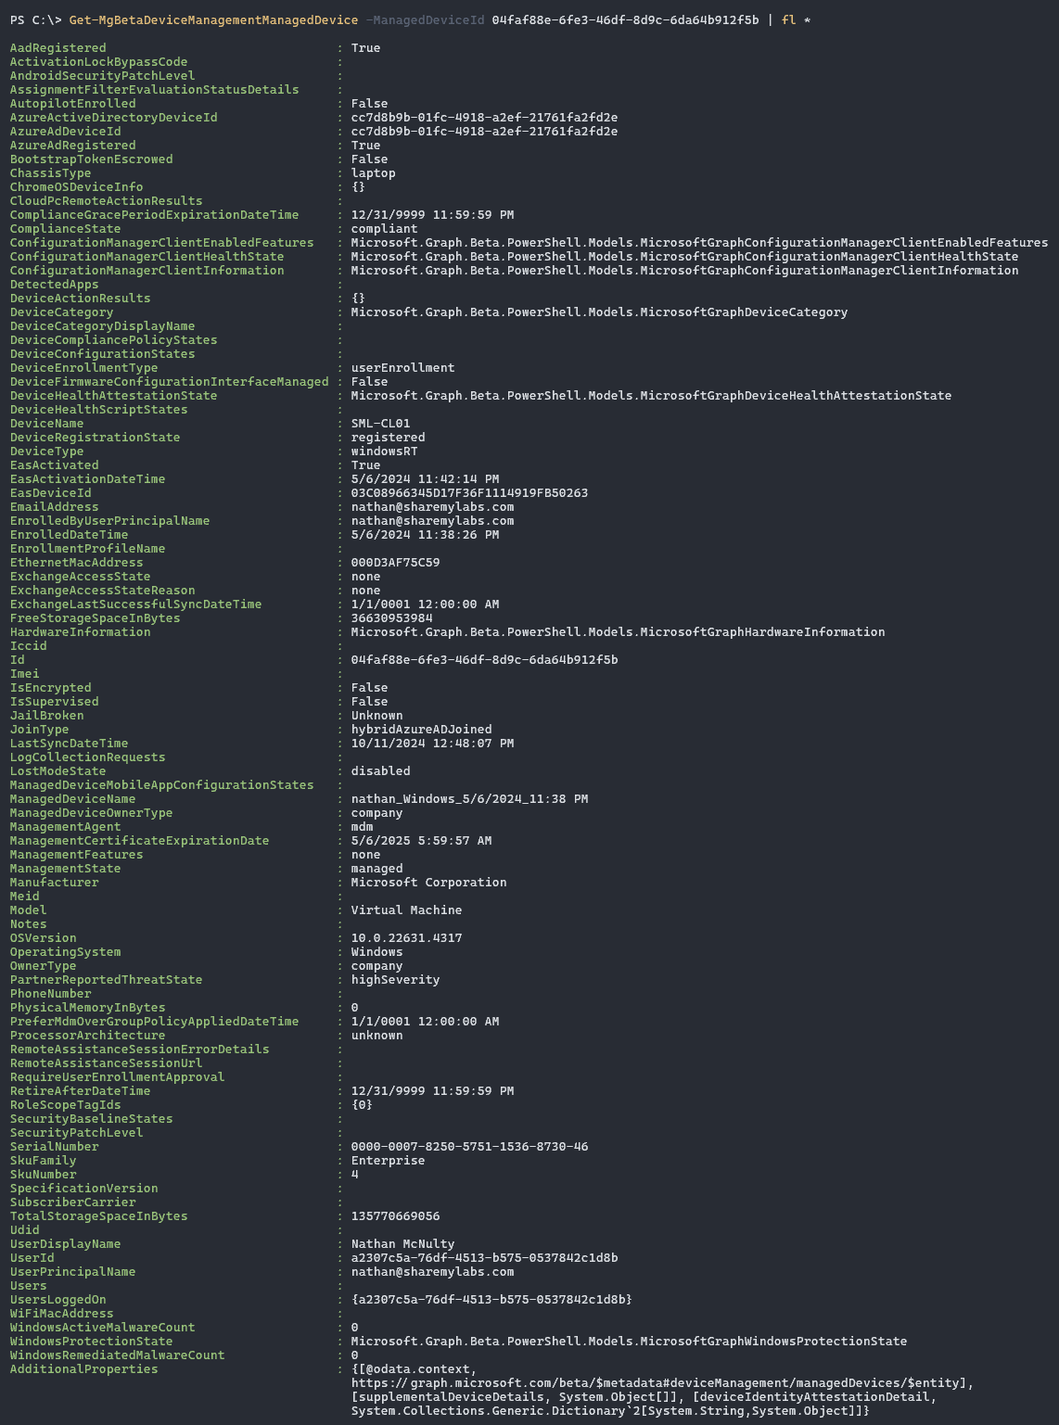
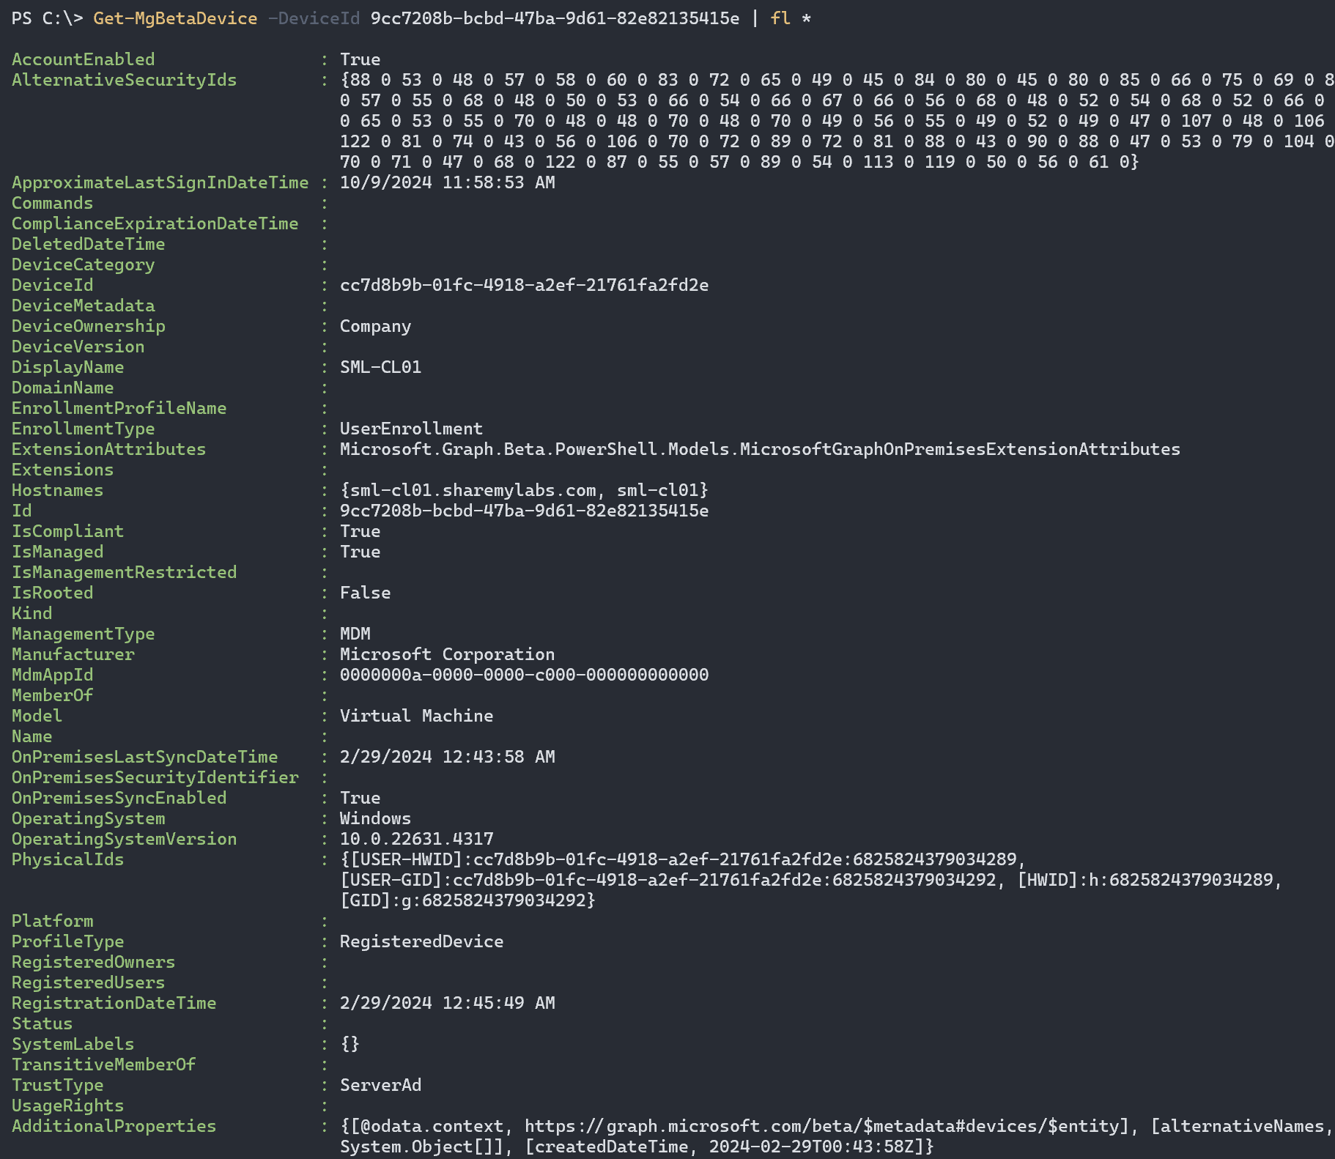
Entra vs Intune 😎
Notes:
We’ll take a closer look during demo and Q&A, but the important thing to note is that Intune populates a small subset of its data into Entra. In most cases, anything device management related will have far more data available in Intune.

Slide 24
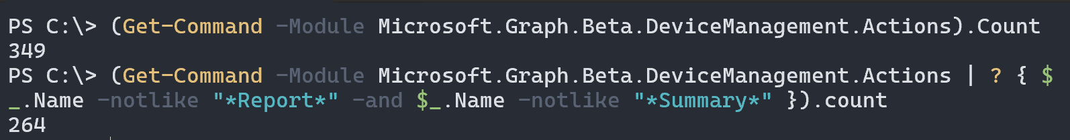
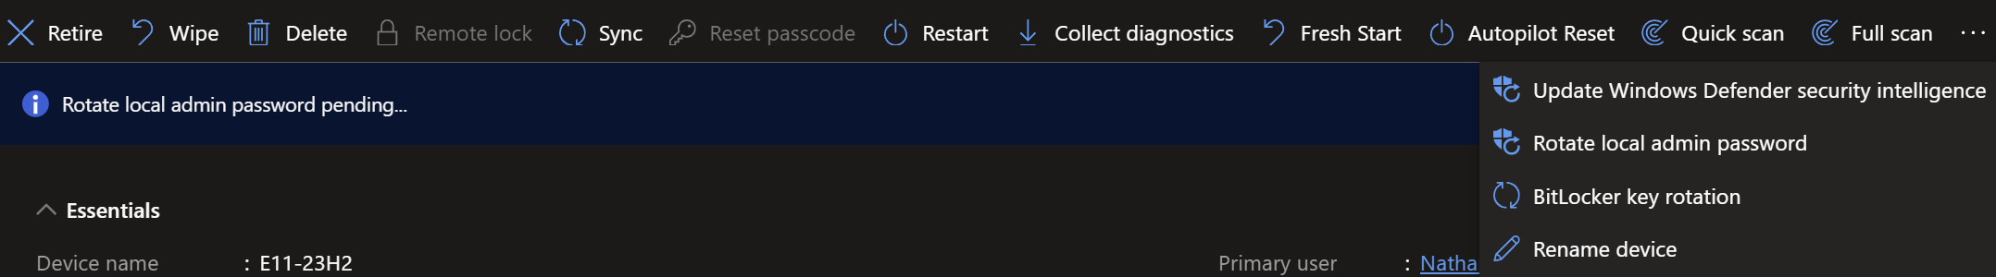
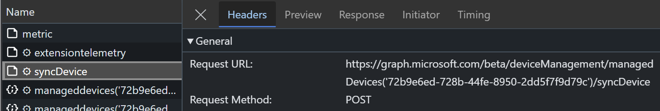
Actions! 🎥
Sync-MgDeviceManagementManagedDevice -ManagedDeviceId $deviceId
Notes:
Using Find-MgGraphCommand -uri "/deviceManagement/managedDevices“ doesn’t work well here
We could use Get-Command *sync* or we can search Graph API docs for syncDevice, the examples show the mapping PowerShell command as:
Sync-MgDeviceManagementManagedDevice -ManagedDeviceId $managedDeviceId

Slide 25
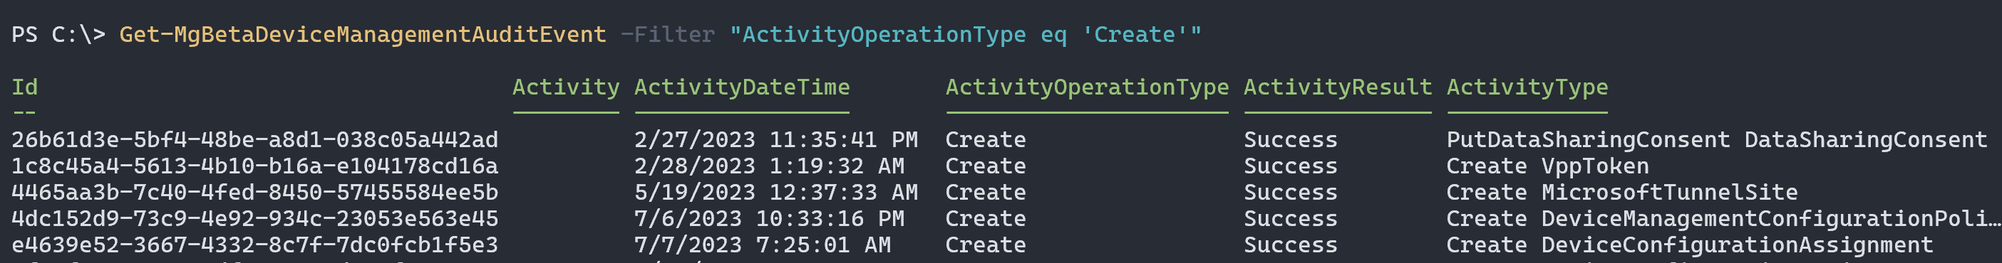
Bonus: Intune Audit Logs
We can use these logs to track changes being made
We might want to monitor for specific events to trigger actions
Requires DeviceManagementApps.Read.All permissions
Use Get-MgBetaDeviceManagementAuditEvent with –Filter!
-Filter "ActivityOperationType eq 'Create'"
-Filter "endswith(ActivityType,'MobileAppAssignment')"
Notes:
I know nobody else makes rapid changes and test them and then can’t figure out which policy was applied when I had an issue come up :p
(Get-MgBetaDeviceManagementAuditEvent -Property ActivityType).ActivityType | Select-Object -Unique
Get-MgBetaDeviceManagementAuditEvent -Filter "ActivityOperationType eq 'Delete'" -Top 200 | Sort-Object ActivityDateTime

Slide 26
Exploring Intune Graph API
Lots of data lives here
Notes:
Explain differences between (Entra) Get-MgDevice and (Intune) Get-MgBetaDeviceManagementManagedDevice
Quickly show Get-Command *-MgBetaDevciceManagement*, filter out count, filter to just Get, Invoke, Update (TL;DR – lots of API endpoints)
Discuss nuance with LIST vs GET and needing to request attributes that aren’t provided by default:
No: (Get-MgBetaDeviceManagementManagedDevice -All).DetectedApps
No: (Get-MgBetaDeviceManagementManagedDevice -All -ExpandProperty detectedApps).DetectedApps
No: (Get-MgBetaDeviceManagementManagedDevice -ManagedDeviceId 04faf88e-6fe3-46df-8d9c-6da64b912f5b).DetectedApps
Yes: (Get-MgBetaDeviceManagementManagedDevice -ExpandProperty detectedApps -ManagedDeviceId 04faf88e-6fe3-46df-8d9c-6da64b912f5b).DetectedApps
Show how we get the right filter with UserLoggedOn:
Get-MgBetaDeviceManagementManagedDevice -Filter "UsersLoggedOn/any(i:i/UserId eq 'a2307c5a-76df-4513-b575-0537842c1d8b')"
(Get-Command -Module Microsoft.Graph.Beta.DeviceManagement.Actions).Name
Show how we can get the API calls for these actions, especially if unsure of which cmdlet to use
While reports do have export buttons, we can get access to the data into objects using Get-MgBetaDeviceManagementReport*
This is useful if we need to combine data from multiple reports or want to perform automated actions
https://learn.microsoft.com/en-us/graph/api/resources/intune-devices-manageddevice?view=graph-rest-1.0
https://graph.microsoft.com/v1.0/deviceManagement/managedDevices
azureADDeviceId
Find device
https://graph.microsoft.com/v1.0/deviceManagement/managedDevices?$filter=azureADDeviceId eq 'da2f6920-d585-4e47-a9e5-71ae18e8456b’
Change Ownership (takes a loong time)
PATCH https://graph.microsoft.com/v1.0/deviceManagement/managedDevices/72b9e6ed-728b-44fe-8950-2dd5f7f9d79c
{
"managedDeviceOwnerType" : "personal"
}
Show updating assigned user
POST https://graph.microsoft.com/beta/deviceManagement/managedDevices('04faf88e-6fe3-46df-8d9c-6da64b912f5b')/users/$ref
{"@odata.id":"https://graph.microsoft.com/beta/users/765880c0-813b-40e7-910c-9bcc3de55646"}

Slide 27
Data Warehouse 13
Gaining access to the (not so) secret data warehouse
Exploring the collections and data
Automation and reporting opportunities
Notes:
The Intune data warehouse is interesting – it’s not often used, sometimes due to concerns around Power BI licensing, but also because it doesn’t expose data directly in the portal and feels very complicated to use.
We all know Power BI is used heavily for creating reports/dashboards, and this works well for things like tracking enrollment status, compliance, policy failures, and MAM check-ins. Very useful for trending data, especially if we build dashboards to monitor new rollouts, something I’m seeing done more often ☺
What many don’t realize is that we can get at the data with PowerShell as well, no need to use Power BI. The trick here is that we have to create an app registration (SP) in Entra and grant it the correct permissions, and it supports both delegated and application based permissions making it useful for many scenarios.
Entities: Application, Date, Devices, Intune Management Extension, Policy, Mobile App Management (MAM), User, User Device Associations

Slide 28
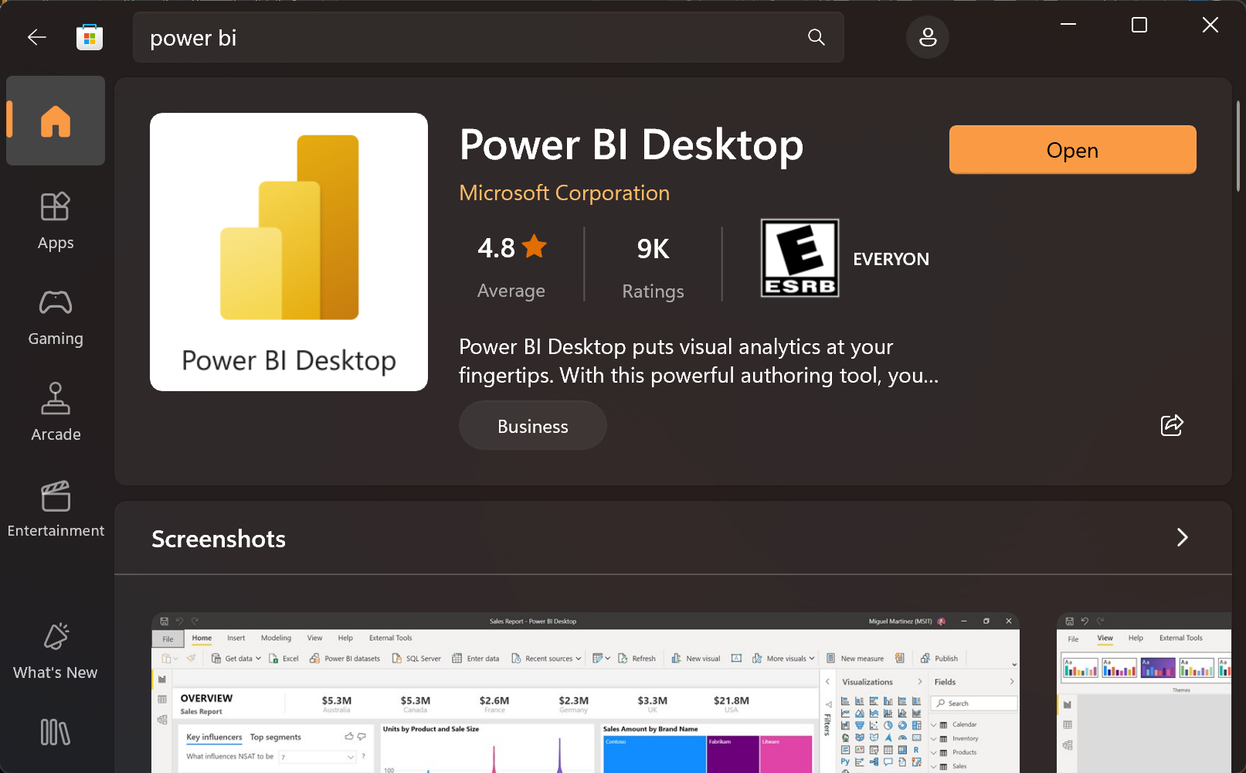
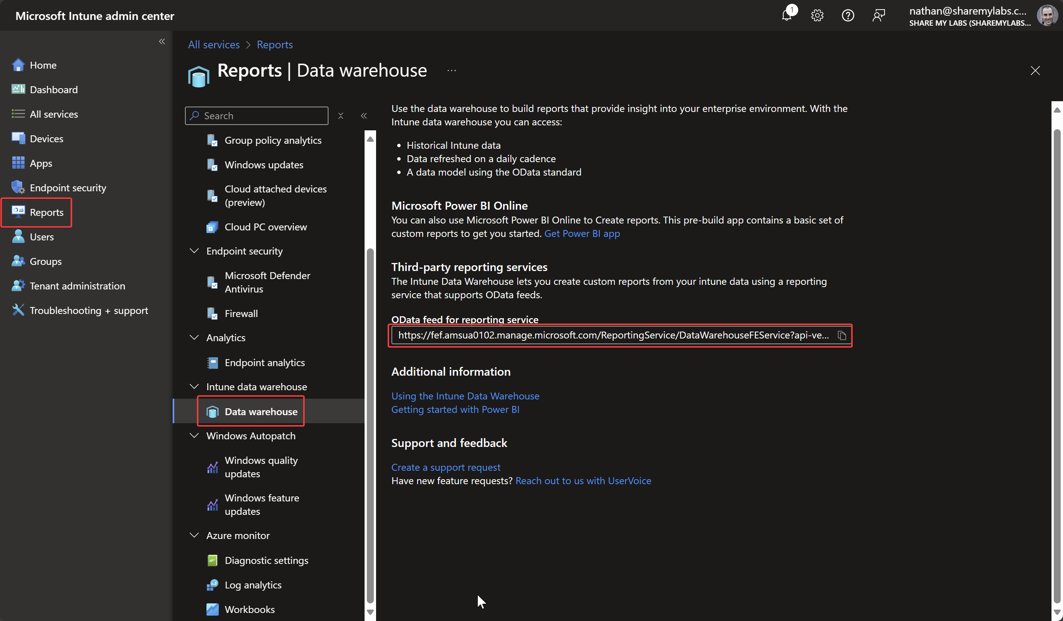
Opening the doors
Notes:
Just a quick visual to help people kick off the install and get the right endpoint

Slide 29
Exploring Data Warehouse
It’s a not a very big warehouse
Notes:
https://appsource.microsoft.com/en-us/product/power-bi/pbi_intune.intune_compliance_dw_app?tab=Overview
Show how to install Power BI Desktop and connect to the Data Warehouse
Data model is available in the docs:
https://learn.microsoft.com/en-us/mem/intune/developer/reports-ref-data-model
Show the various tables and data, highlight use cases like Compliance changes and MAM check-ins for troubleshooting
We can also access via API and even export via PowerShell (lots of examples!):
https://github.com/microsoft/Intune-Data-Warehouse
https://techcommunity.microsoft.com/t5/intune-customer-success/support-tip-using-powerbi-to-build-custom-reports-with-intune/ba-p/294970

Slide 30
Remediations
Using Remediations to collect data
Automating Remediations and collection with Graph API
Community resources and samples
Notes:
History of CIs/baselines -> Remediations

Slide 31
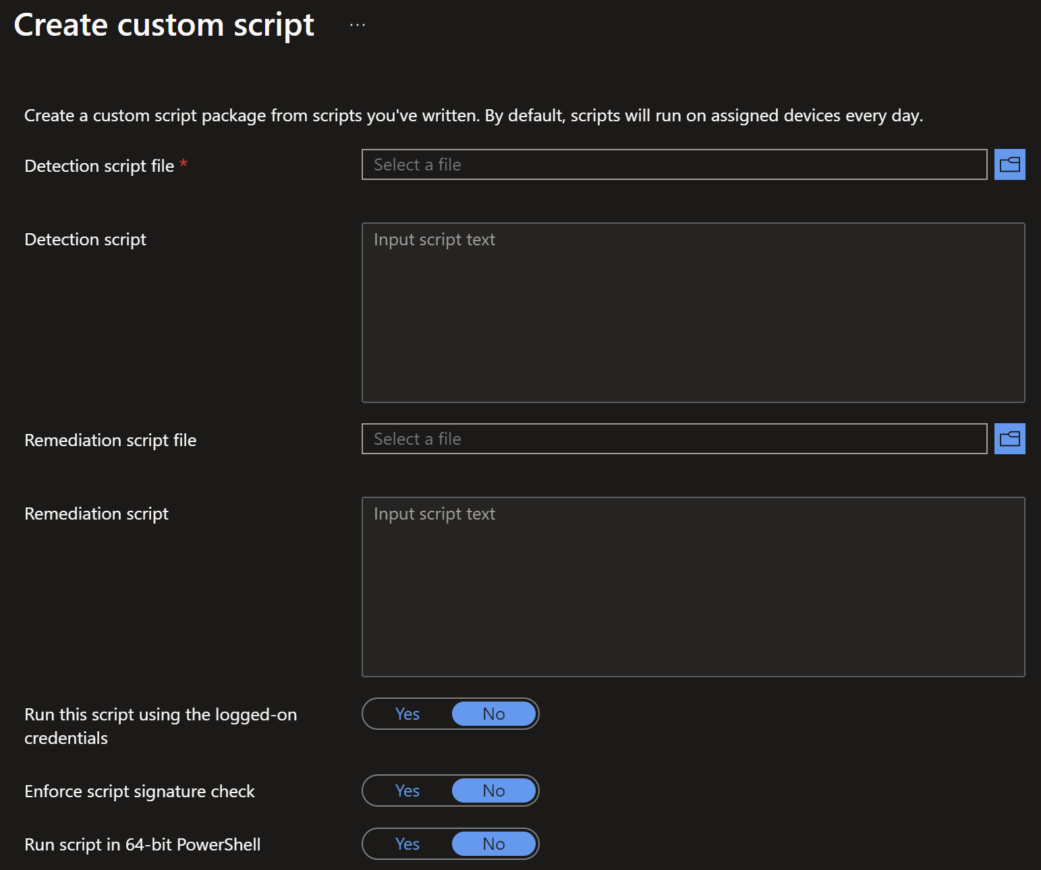
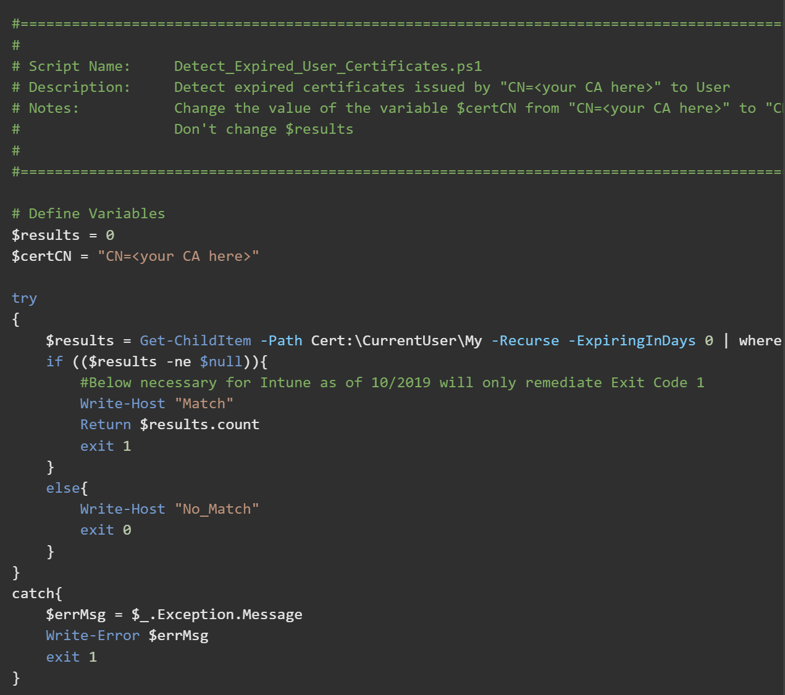
Anatomy of a remediation script
Notes:
https://learn.microsoft.com/en-us/mem/intune/fundamentals/powershell-scripts-remediation

Slide 32
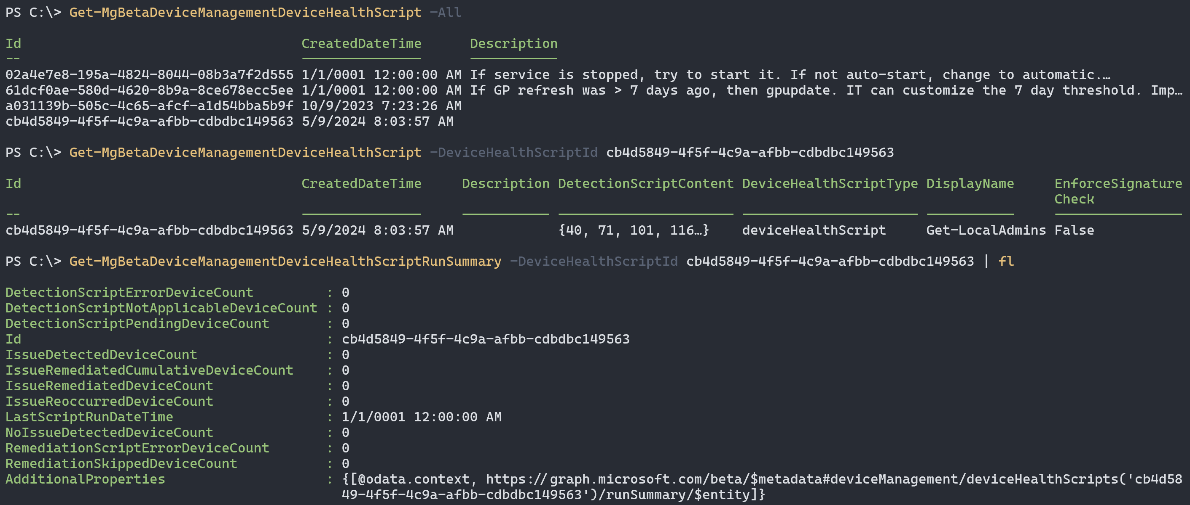
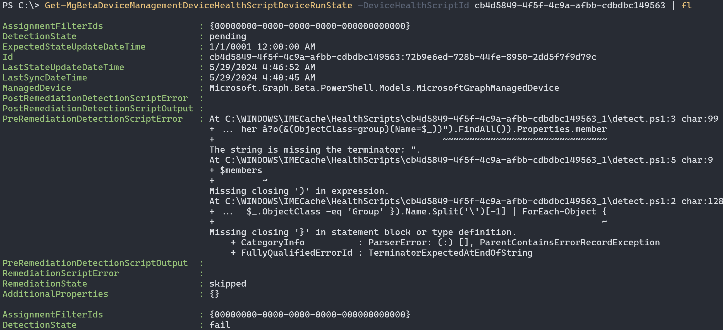
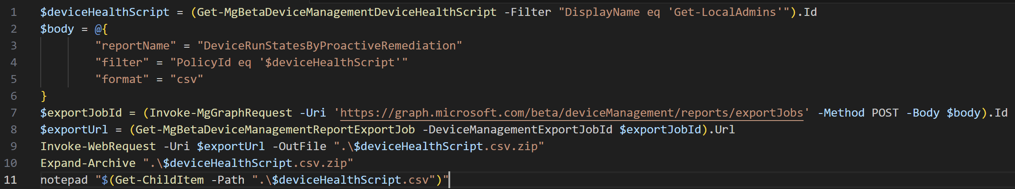
Automating Remediation Scripts?!?
Notes:
Get-MgBetaDeviceManagementDeviceHealthScript –All
Get-MgBetaDeviceManagementDeviceHealthScript -DeviceHealthScriptId cb4d5849-4f5f-4c9a-afbb-cdbdbc149563
Get-MgBetaDeviceManagementDeviceHealthScriptRunSummary -DeviceHealthScriptId cb4d5849-4f5f-4c9a-afbb-cdbdbc149563
Get-MgBetaDeviceManagementDeviceHealthScriptDeviceRunState -DeviceHealthScriptId cb4d5849-4f5f-4c9a-afbb-cdbdbc149563
Full output:
$deviceHealthScript = (Get-MgBetaDeviceManagementDeviceHealthScript -Filter "DisplayName eq 'Get-LocalAdmins'").Id
$body = @{
"reportName" = "DeviceRunStatesByProactiveRemediation"
"filter" = "PolicyId eq '$deviceHealthScript'"
"format" = "csv"
}
$exportJobId = (Invoke-MgGraphRequest -Uri 'https://graph.microsoft.com/beta/deviceManagement/reports/exportJobs' -Method POST -Body $body).Id
$exportUrl = (Get-MgBetaDeviceManagementReportExportJob -DeviceManagementExportJobId $exportJobId).Url
Invoke-WebRequest -Uri $exportUrl -OutFile ".\$deviceHealthScript.csv.zip"
Expand-Archive ".\$deviceHealthScript.csv.zip"
notepad "$(Get-ChildItem -Path ".\$deviceHealthScript.csv")"

Slide 33
Exploring Remediations
If the data doesn’t exist, we can fix that
Notes:
https://github.com/JayRHa/EndpointAnalyticsRemediationScripts
https://www.joeyverlinden.com/my-most-used-proactive-remediations/
Need to show creating via graph, then retrieving results
https://www.systanddeploy.com/2020/12/manage-intune-proactive-remediation.html
Invoke-WebREquest -Uri "https://github.com/JayRHa/EndpointAnalyticsRemediationScripts/archive/refs/heads/main.zip" -OutFile C:\Users\NathanMcNulty\Downloads\remediations.zip
Expand-Archive ".\remediations.zip“
$path = ".\remediations\EndpointAnalyticsRemediationScripts-main\Get-BitlockerRecoveryKey“
$detection= [convert]::ToBase64String((Get-Content $path\detection_BitlockerRecoveryKey.ps1 -AsByteStream))
$remediation = [convert]::ToBase64String((Get-Content $path\remediation_BitlockerRecoveryKey.ps1 -AsByteStream))
Connect-MgGraph –Scopes DeviceManagementConfiguration.ReadWrite.All
$body = @{
"@odata.type“ = "#microsoft.graph.deviceHealthScript"
publisher = "JayRHa"
version = “1"
displayName = "Remediation package test"
description = ""
detectionScriptContent = "$detection"
remediationScriptContent = "$remediation"
runAsAccount = "system"
runAs32Bit = "False"
}
Invoke-MgGraphRequest -Method POST -Uri "https://graph.microsoft.com/beta/deviceManagement/deviceHealthScripts" -Body $body

Slide 34
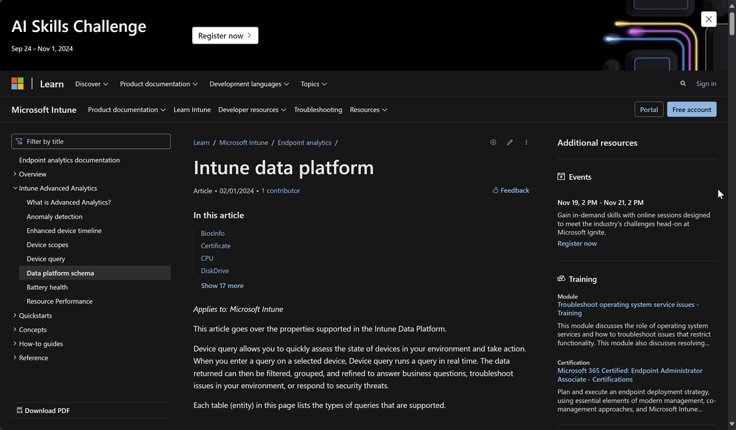
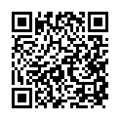
Device Query
https://learn.microsoft.com/en-us/mem/analytics/device-query
Notes:
Like CMPivot
https://learn.microsoft.com/en-us/mem/analytics/data-platform-schema https://petervanderwoude.nl/post/getting-started-with-device-query/

Slide 35
Exploring Device Query
Like CMPivot, but also not like CMPivot
Notes:
Run through some basic examples:
BiosInfo
Certificate
FileInfo('C:\\Users\\AdrianeMorrison\\Downloads\\')
| where FileName endswith '.exe’
LocalUserAccount
Process
Show how we can run this via API against multiple devices (get group membership, get intune device id, save query in base64, run query)
https://github.com/nathanmcnulty/nathanmcnulty/blob/master/Intune/DeviceQuery.ps1

Slide 36
Defender XDR
The more Defender the better

Slide 37
Advanced Hunting
Look at that schema!
Tips for filtering and finding our data
Bringing in external data sources

Slide 38
Enriching with external data?
In Defender XDR, we’ve always been able to use externaldata()
externaldata (Name:string) ["https://lolbas-project.github.io/api/lolbas.csv"]
The Unified SOC platform now allows us to use _(GetWatchlist)
_GetWatchlist('LOLBAS’)
This means we can use a near free Sentinel to bring in new data!
Watchlists can be maintained by Logic Apps or other automation
Think of querying which members of a group opened an app or email ;)

Slide 39
Exploring Advanced Hunting
Not a simple hunting expedition
Notes:
DeviceNetworkEvents | where ActionType == 'ConnectionSuccess' | where RemoteIPType == 'Public' // I'd add powershell.exe too | where InitiatingProcessVersionInfoOriginalFileName in~ ('wscript.exe','mshta.exe','cscript.exe','conhost.exe','runScriptHelper.exe')
DeviceNetworkEvents | where RemoteIPType == "Public" | where InitiatingProcessVersionInfoOriginalFileName in (( externaldata ( Name:string ) [ "https://lolbas-project.github.io/api/lolbas.csv" ] with (format=csv, ignoreFirstRecord=true) | distinct Name ))
DeviceFileEvents | where FileName has_any ("credential","password") or FolderPath has_any ("credential","password")
Kqlsearch.com

Slide 40
Defender APIs
APIs from the pre-Graph era
Collect more data with Threat Hunting API
Automating collection with Live Response
Performing data-driven Actions
Notes:
Threat Hunting API is part of Graph, the future of hunting our data via API

Slide 41
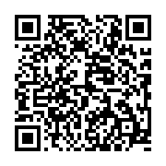
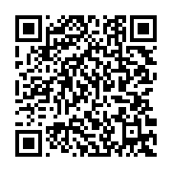
Defender APIs
Defender for Endpoint
Defender for Cloud Apps
Notes:
Defender for Endpoint API: https://learn.microsoft.com/en-us/defender-endpoint/api/apis-intro
Defender for Cloud Apps API: https://learn.microsoft.com/en-us/defender-cloud-apps/api-introduction

Slide 42
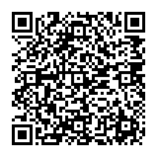
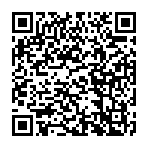
Defender APIs
Defender for Office 365
Defender for Identity
Notes:
Defender for Office 365 API: https://learn.microsoft.com/en-us/graph/api/security-collaborationroot-list-analyzedemails?view=graph-rest-beta
Defender for Identity API:
https://learn.microsoft.com/en-us/graph/api/resources/security-healthissue?view=graph-rest-beta
https://learn.microsoft.com/en-us/graph/api/resources/security-sensor?view=graph-rest-beta

Slide 43
Exploring Defender APIs
The ones that matter anyway
Notes:
Show examples of what we can do with the APIs, especially MDE machine actions and getting MDI health status
Quickly show how to add the APIs, connect, and isolate a VM
$token = Get-Clipboard
$session = New-Object Microsoft.PowerShell.Commands.WebRequestSession
$session.Cookies.Add((New-Object System.Net.Cookie("sccauth", "$token", "/", "security.microsoft.com")))
$headers = @{
"x-xsrf-token" = "BEBZLo5atLL2YGG98fSMiO4beA-9yJR4kWqT6bAFaKH1MIlaqQ2kTTYU6FnvHkjZtMtJxtXPlTT1ibAltwvzqSYJLfScG7c1SnjCgobIAbRqFUclgyWLoECWMylWF1GVVRQp21VWo-5Jh0Pj3l2pSg2:NO5z1uCiv5U9Tw5ODlIpeFVG8Xpevt8vknRiqp1V-11S80yDpwtscuURzF0ppKG5Fp6wy9ElmmD-nvqX7GfFFBxcSA1M1HLRIHcogADCmec_TbvBqcKxLvstg_kpI0HD2JUzW7CyVUd6eoXvA3H7OBfekSRdG-2iYc7D6KgzzWPZflDmOvx0j_hqlcCxpPSO0"
}
$results = Invoke-WebRestMethod -UseBasicParsing -Uri "https://security.microsoft.com/apiproxy/mtp/tvm/analytics/recommendations?pageIndex=1&pageSize=100&`$filter=(status+eq+%27Active%27+or+status+eq+%27PartialException%27)" -WebSession $session -Headers $headers

Slide 44
Extending Defender XDR with Sentinel
The case for Unified SOC Platform
Getting value from free and low-cost sources
Adding new functionality

Slide 45
Exploring Sentinel Integration
We can do what now?
Notes:
Just show how to add the workspace, create a watchlist, and then query the watchlist with KQL
Be sure to mention all the free data sources
If possible, would be nice to show Logic App updating the watchlists

Slide 46
Examples
Oh so many examples :)

Slide 47
Endpoint Security Projects
Application control
AV exclusions and optimization
Outbound filtering
LAPS/Admin rights
Removable storage
BitLocker

Slide 48
User Experiences Projects
Hardware inventory
Performance/Impact analysis
Usage analysis
Authentication methods
Pilots
Notes:
Use Graph API to collect info about OS version of phones to determine eligibility for passkeys in Microsoft Authenticator

Slide 50
Notes:
Speakers, please stay on this page for the second half of your session.

